Slide 1
CIS 490H/590J Edge Computing
Project Initiation & Paper Presentation
Winter 2023
Prof. Zheng Song
zhesong@umich.edu

Slide 2

Paper Presentation
General Suggestions:
Communicate the key Ideas;
Don’t get bogged down in details (refer them to the paper)
Structure your talk
Know your audience (‘s expertise)
Use an organized approach:
Introduction (should not lose audience)
Body (may lose audience a little here)
Conclusion (should not lose audience)
Notes:
Make sure everyone understand you: know your audience.
You want audience to know the problem and show them you have a solution.

Slide 3
1.1 the Introduction
Define the problem
Motivate the audience (why the world will end and your cat will die if we don’t solve this problem!)
Introduce terminology (keep the jargons to a minimum)
Discuss earlier work (show how they did not [fully] solve the problem)
Emphasize the contributions of the paper (towards solving the problem)
Put your conclusions first (to capture interested audience members)

Slide 4
1.2 The Body
Abstract the major results?
Explain the significance of the results
Sketch a proof of the crucial results
Use tables (simple) and pictures
Don’t go too deep into your solution (“The secret to being a bore is to tell everything.)
Put a written conclusion at the bottom of each key slide
Notes:
Summarize key novelty (solution idea) in one sentence (preferred).

Slide 5
1.3 The Conclusion
Repeat your conclusions introduced previously
Be open about problems
Take questions.
Notes:
Give your viewpoint

Slide 6
2. How to choose good papers to read?
A） Selecting from Good conferences and journals
Good Conferences:
Communication: INFOCOM, SIGCOMM, IMC, NSDI
Mobile and Distributed Computing: Mobisys, Sensys, ICDCS
System: EuroSys, ATC, OSDI
Edge Computing: SEC, EDGE, HOTEDGE
IoT: IoTDI
Good Journals: ACM/IEEE Transaction on …
https://anrlutdallas.github.io/resource/projects/fog-computing-conferences.html
Notes:
SEC conference is best edge computing journal; hosted by IEEE and ACM
USENIX conference is also top journal for edge computing sponsored by IEEE and ACM

Slide 7
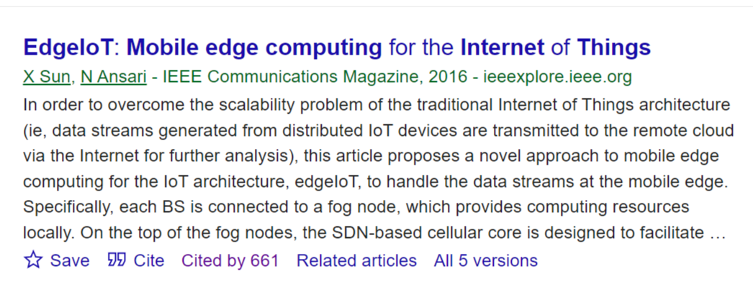
2. How to choose good papers to read?
B) Read the papers cited by good papers
C) Read the papers citing the paper you are interested in:

Slide 8
3. Project Initiation
What is a research problem
How to identify a research problem
Some Example Projects
Workload

Slide 9

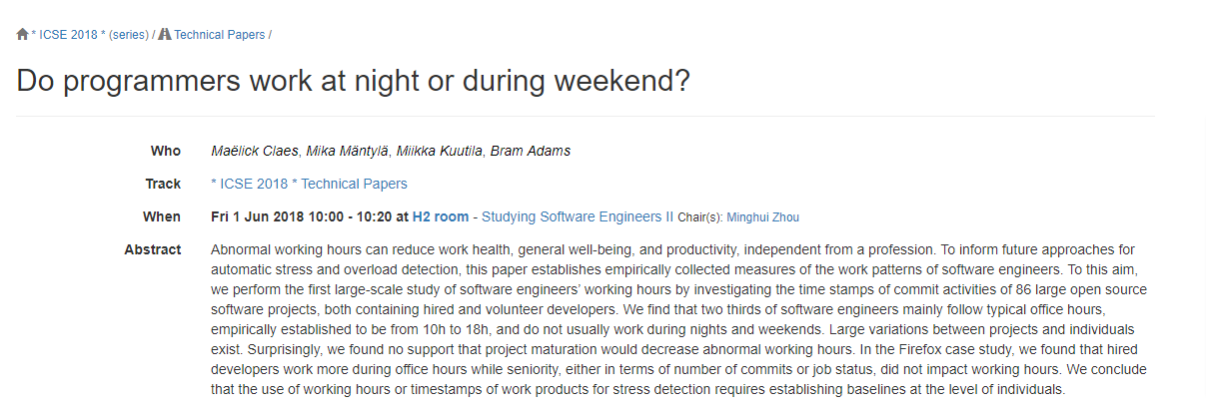
What is a research question?
My Ph.D. advisor: research is to explore the boundary of human knowledge
E.g., Do programmers work at night or during weekend?
It make sense… but….

Slide 10
What is a research question?
Nobody has solved it before and nobody knows how to solve it.
A specific problem that could be answered by your proposed solution
Solving it can cause an impact.
The solution should be verifiable.

Slide 11
How to find the research problem?
Problem first:
Find a widely accepted problem
Search for other solutions, think of their limitations
Propose your own solution
Solution first:
Inspired by something, think of a solution
Search for related work, check if anyone else has thought of this solution before
Find a problem for this solution (a hammer looking for a nail)

Slide 12
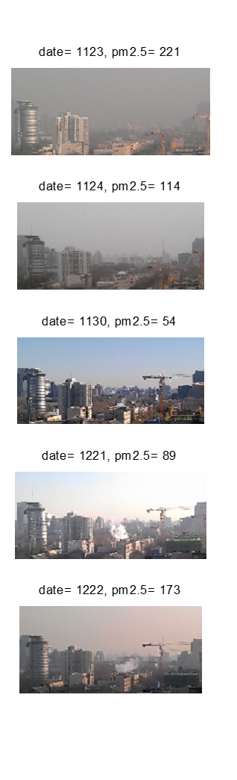
Research I am proud of…
Background: heavy air pollution in China in around 2013
Citizens need to monitor the Air Quality Index to decide their daily activities (PM2.5, particulate matter)
A robot posts photos of road traffic taken from the same spot every half an hour

Slide 13


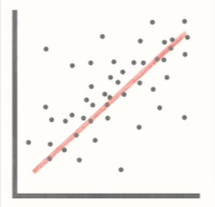
Image-based Pm2.5 Estimation!
Is it possible?
Download 100 images manually
Download PM2.5 reading provided by a nearest weather station
Convert the images to grayscale, calculate the average grayscale
Calculate the correlation between average grayscale and PM2.5
Yes, it is possible!

Slide 14
Image-based Pm2.5 Estimation
Is it meaningful?
13 weather station monitoring PM2.5 in Beijing, with a population of 40+ million. PM2.5 sensors are expensive. People need a more fine-grained PM2.5 estimation. (cause an impact)
Nobody tried to estimate PM2.5 by images at that time! (nobody knows how to do it!)
Yes, it is meaningful!

Slide 15
Image-based Pm2.5 Estimation
Problem to Solve:
Why the problem is important:
What is our solution:
The secret sauce:
Notes:
Try to follow this template

Slide 16
Image-based Pm2.5 Estimation (my answers)
Problem to Solve: fine-grained PM2.5 estimation without PM2.5 sensors
Why the problem is important: help residents to plan their daily activities
What is our solution: Camera-based PM2.5 estimation
The secret sauce: correlation between Pm2.5 and image grayscale

Slide 17
Workload
An average of 10 hours per week to work on this course
2.5 hours on lectures
2.5 hours on papers and presentation
5 hours on engineering work * 12 weeks = 60 hours per person
Keep your workload in a manageable level:
Design != Implementation.
Evaluation = Implementation + Simulation (Emulation)
Still need to implement some part of your design to show its applicability
Work with your team and leverage your strength

Slide 18
Oblique Scalability: Improving Throughput in Resource-Constrained Edge Systems
CIS590J Course Project
Notes:
Vertical scalability: scale up → upgrade current system (improve hardware).
More advanced hardware to serve more users
Horizontal scalability: scale out → buy new machines and add it to the system.
Use more hardware to serve more users
Oblique scalability: improve system by simply making it more efficient through some ingenuity (no additional hardware amount or upgrades/advances required)

Slide 19
Background
Throughput in edge system is hard to Improve
Edge system features limited resources (e.g., CPU, Memory, and Network) at runtime
Vertical and horizontal scalability by allocating more resources works for cloud platform, not for edge platform
Oblique scalability, which improves the throughput of an edge system without requiring to allocate additional resources
Equivalent methods relying on dissimilar resources fulfill one application requirement
Combined execution of equivalent methods may better use of all the aviation resources
Motivated Example: face image recognition application
Edge-based method: both extracting features and comparison at the edge (Computing)
Cloud-based method: upload the raw image to the cloud (Networking)
Hybrid method: extracting features at the edge, then upload only the features to the cloud (Computing & Networking)
Notes:
So it seems that the whole idea of edge computing is to balance networking and computing to provide overall more efficient system under our current infrastructure (or with some additional infrastructure).
We need to combine cloud, edge, and hybrid methods into an overall hybrid method to always fully utilize computational and networking resources.

Slide 20
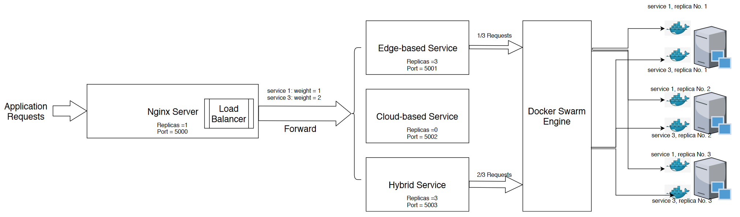
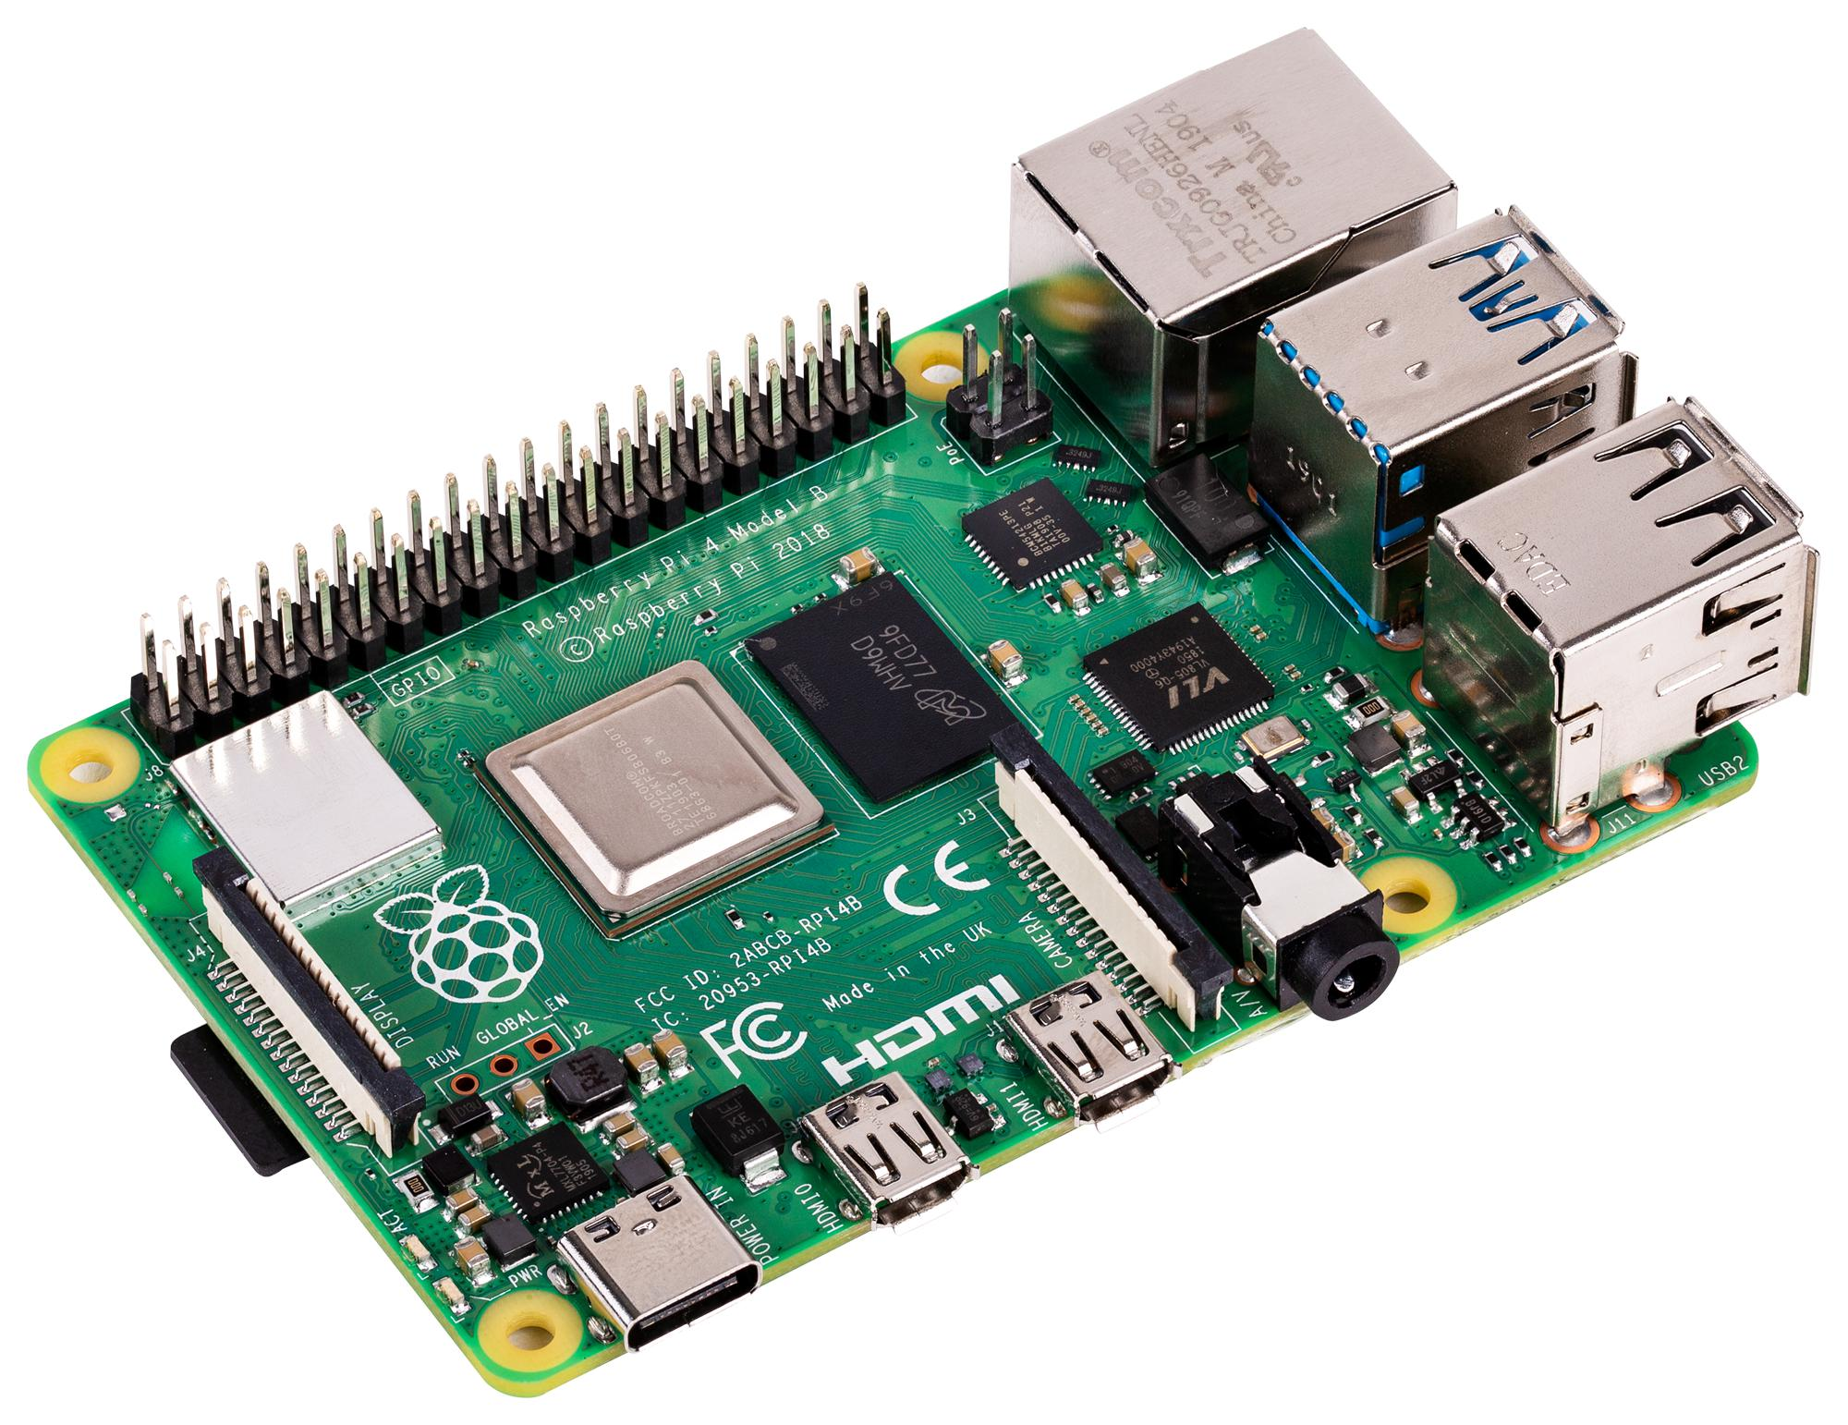
Solution Overview
Build the whole system for the face recognition application (Nginx, Docker/K8s)
Tentative Evaluation
How many Docker replicas to configure for each equivalent method?
How to assign the weights in the Nginx load balancer?
What you will receive after finishing the project?
Knowledge of using tools, building edge system, and interacting with IoT devices
Produce one paper that may will be submitted to an international conference/journal

Slide 21
ReDir: Reliable Walking Direction Estimation using COTS Devices

Slide 22
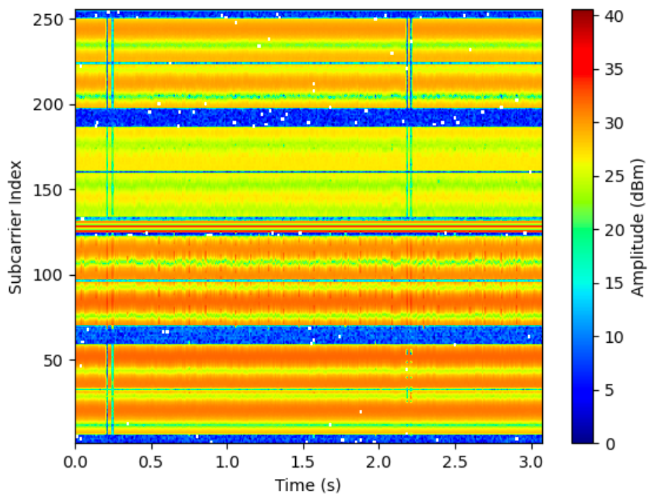
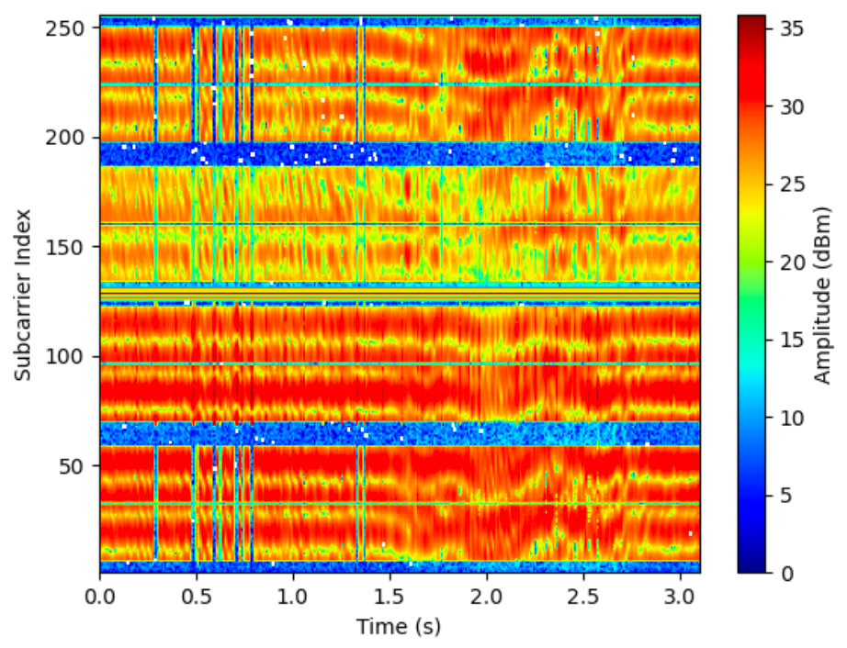
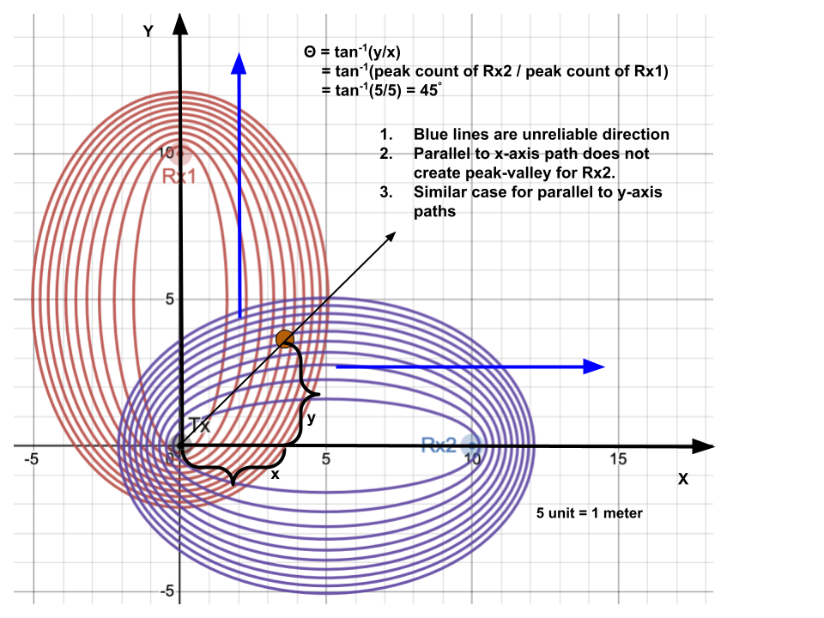
Preliminary and Existing Challenges
Channel State Information (CSI)
CSI measures multipath effects on a transmitted signal
Static object (wall, furniture etc) affects multipath in a consistent manner; dynamic objects (human bodies) have variable effect on observed CSI data (Fig. 1).
For each subcarrier n, CSI is represented by complex number C_{n} = |C_{n}| exp (j.θ), where |C_{n}| is amp, θ is phase
Fresnel Zone Theory
A series of confocal ellipsoidal regions of space between and around a Tx and a Rx.
Human while walks along a radio propagation path, creates peaks and valley in FZ.
Peak count/fluctuation period count in CSI represents distance in FZ (Fig. 2).
Existing Challenges/problems
Heavy training effort required
Unreliable walking direction (Fig. 2)
Initial and final location estimation along with direction
Time delay accumulates error when environment changes
Fig.1a: CSI reading while “still”
Fig.1b: CSI reading while “walking”
Fig.2: Distance in Fresnel zones and unreliable direction
Fig 1 Ref: Wifi-based human activity recognition using raspberry pi
Notes:
What if receiver and transmitter were spinning in sync so as to not have any dead zones???

Slide 23
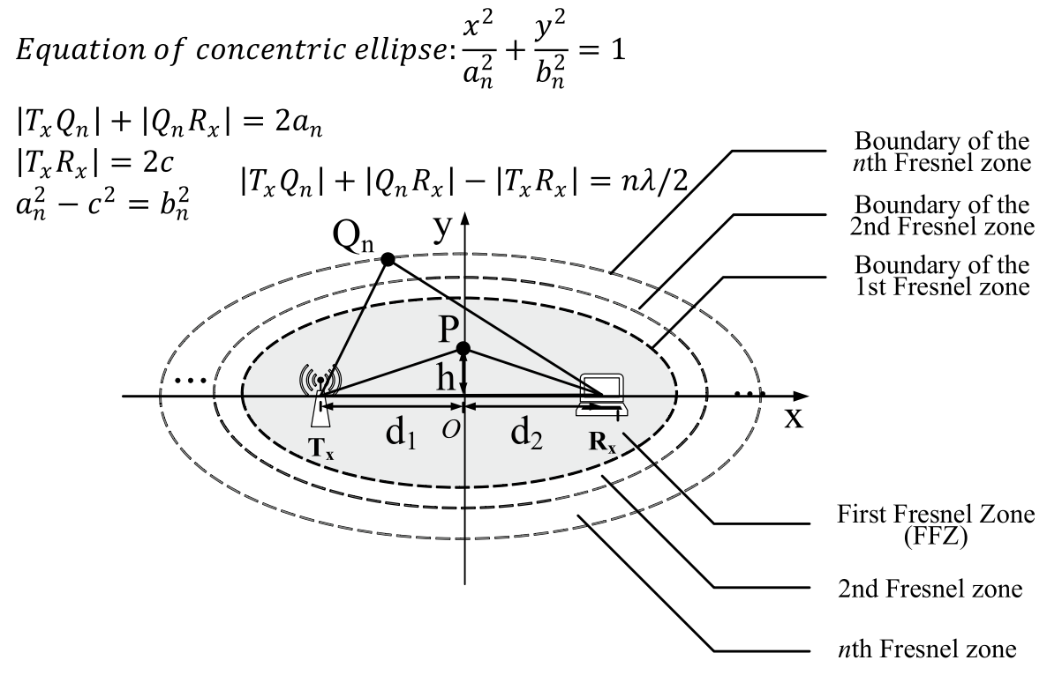
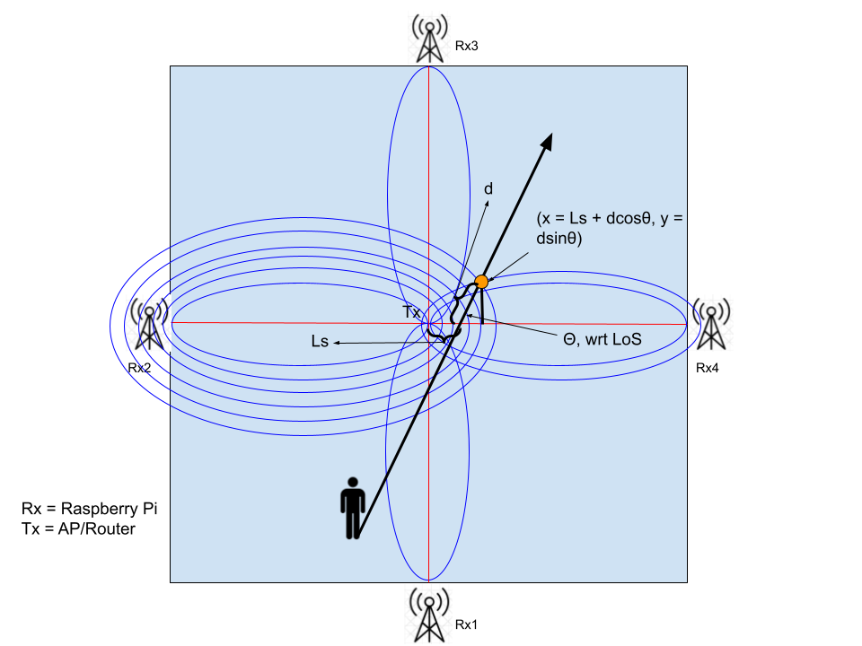
Our Approach (ReDir)
ReDir infers direction when user crosses any one of the 4 LoS.
How to know when user crosses LoS?
From CSI reading
From the intersection (orange dot) of 2 ellipses resides at opposite side (FZ of Rx2 and Rx4), we get 1 pair of ellipse equation:
𝜀₁ : (X-C)² / a_{1n}² + (Y² / b_{1n}²) = 1
𝜀₂ : (X+C)² / a_{2n}² + (Y² / b_{2n}²) = 1
Putting x = Ls + dcosθ and y = dsinθ into the above 2 equations, we get Ls and θ (assuming d known).
Given,
|T_{x}Q_{n}| + |Q_{n}R_{x}| - |T_{x}R_{x}| = nλ/2
|T_{x}Q_{n}| + |Q_{n}R_{x}| = 2a_{n}
|T_{x}R_{x}| = 2C
3a can be rewritten as, 2a_{n} - 2C = nλ/2
Again we know by def, a²_{n} - C² = b²_{n}
C and λ is known, thus we get a_{n} and b_{n} by solving Eq 3d and 3e.
Along with direction θ, ReDir also provides final (x, y) location of user.
Similar strategy for unreliable directions.
Fig 3: Geometry of Fresnel Zone
Fig 3 Ref: Contactless Human Activity Analysis, Springer
Fig 4: ReDir Approach

Slide 24
Enabling technologies for Cloud/ Edge
A Detailed Survey
Professor Dr. Zheng Song
Summit Shrestha

Slide 25
Background
Popularity and success of cloud computing in the past few decades
Properties of Cloud:
Scalability & Elasticity
Availability & Reliability
Interoperability & Portability
Privacy and Security
These properties contributed towards the success of cloud computing
Edge computing - a new paradigm, an extension of the cloud, decreases latency and bandwidth

Slide 26
Research Questions
R1: What are the state-of-the-art key enabling technologies for each of the cloud properties?
R2: Can the same technologies be used for edge? Why or why not?
R3: What is different in edge and what needs to be further considered?
R4: What are the existing research works and solutions for achieving these properties in edge?
R5: What are the challenges in achieving the same cloud properties in edge?
R6: What are the unique opportunities and future working directions for edge?

Slide 27
Methodologies
Reading and summarizing at least 40 existing papers related to the key enabling technologies for cloud and edge
Comparing, contrasting, and dividing the key enabling technologies into categories and sub-categories
Structuring the survey paper based on the categories and sub-categories
Describing each category and providing supporting statements based on the reference papers
Reiterating for improvements
Submitting the paper

Slide 28
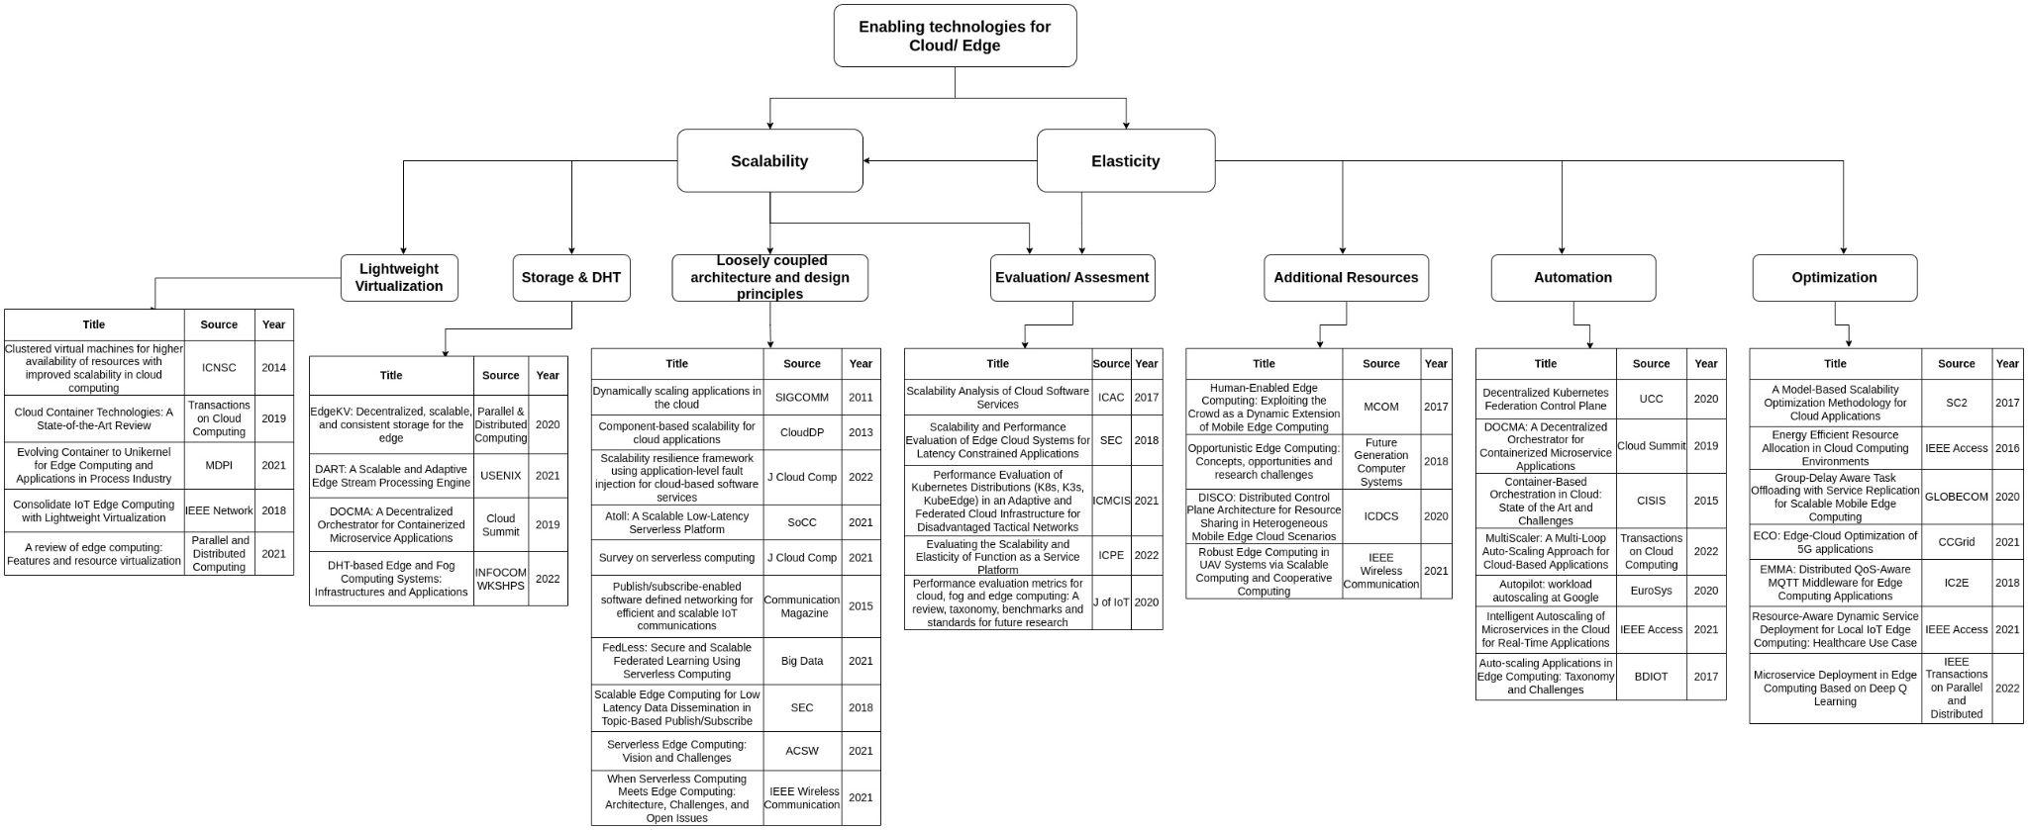
Related Papers & Categories

Slide 29
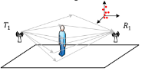
BMI Measurement by CSI
Pic taken from [2]

Slide 30
Problem Statement
Using a Machine Learning model, trained on captured CSI data (When a subject crosses a particular area, where CSI (Channel State Information) is captured using Wifi router as transmitter and 2-3 Raspberry Pi s as receivers) , estimate the Body Mass Index(BMI) of the person.

Slide 31
Concepts/Activities/Modules involved
Setup Design
A suitable setup consisting of a router and few Raspberry pi s - captures maximum CSI
Data Collection and preprocessing
Collection of CSI data
Using persons of varied BMIs
Modelling
Modelling of ML algorithm
Training of ML Model
Testing
Test the ML model for BMI estimation
Result comparison, analysis and interpretation

Slide 32
Literature
Person Recognition using Wifi CSI [1]
CSI-Net - A CNN based architecture - For Body Characterization and Activity Recognition [3]
Image based Person perception using Wifi[2]
Human Identity Identification with Wifi CSI using Deep Learning [4]

Slide 33
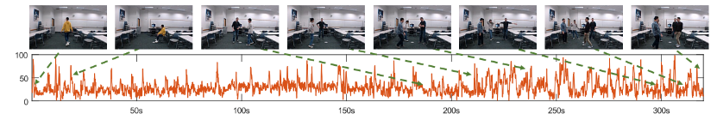
CSI Representation
CSI amplitude varies finely w.r.t movement btw receiver and transmitter. Pic from [2]

Slide 34
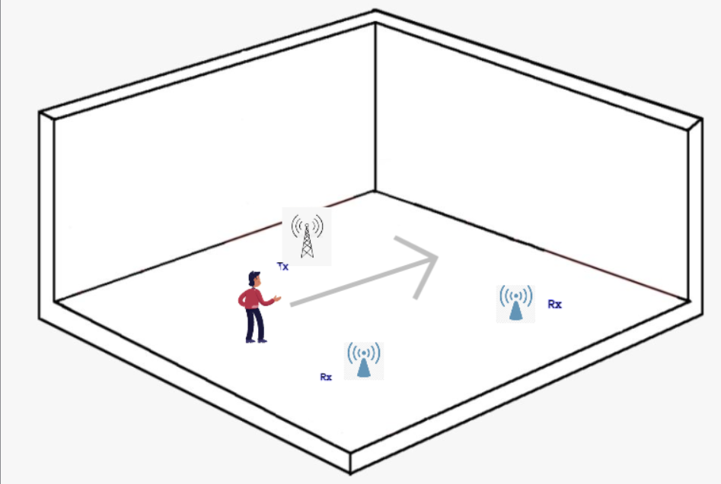
Proposed Setup

Slide 35
Some ML Techniques that can be employed
Traditional
Linear SVM
kNN
Multi Layered Perceptron
CNN Classifiers
Resnet
VGG

Slide 36
References
[1] Person Recognition Using Wi-Fi Channel State Information in an Indoor Environment, ICCE 2020
[2] Person-in-WiFi: Fine-grained Person Perception using WiFi, ICCV 2019
[3] CSI-Net: Unified Human Body Characterization and Pose Recognition, arXiv 2018
[4] Wihi: WiFi Based Human Identity Identification Using Deep Learning, IEEE Access 2020

Slide 37
UAV-Assisted Event Detection for Ground-Vehicles

Slide 38
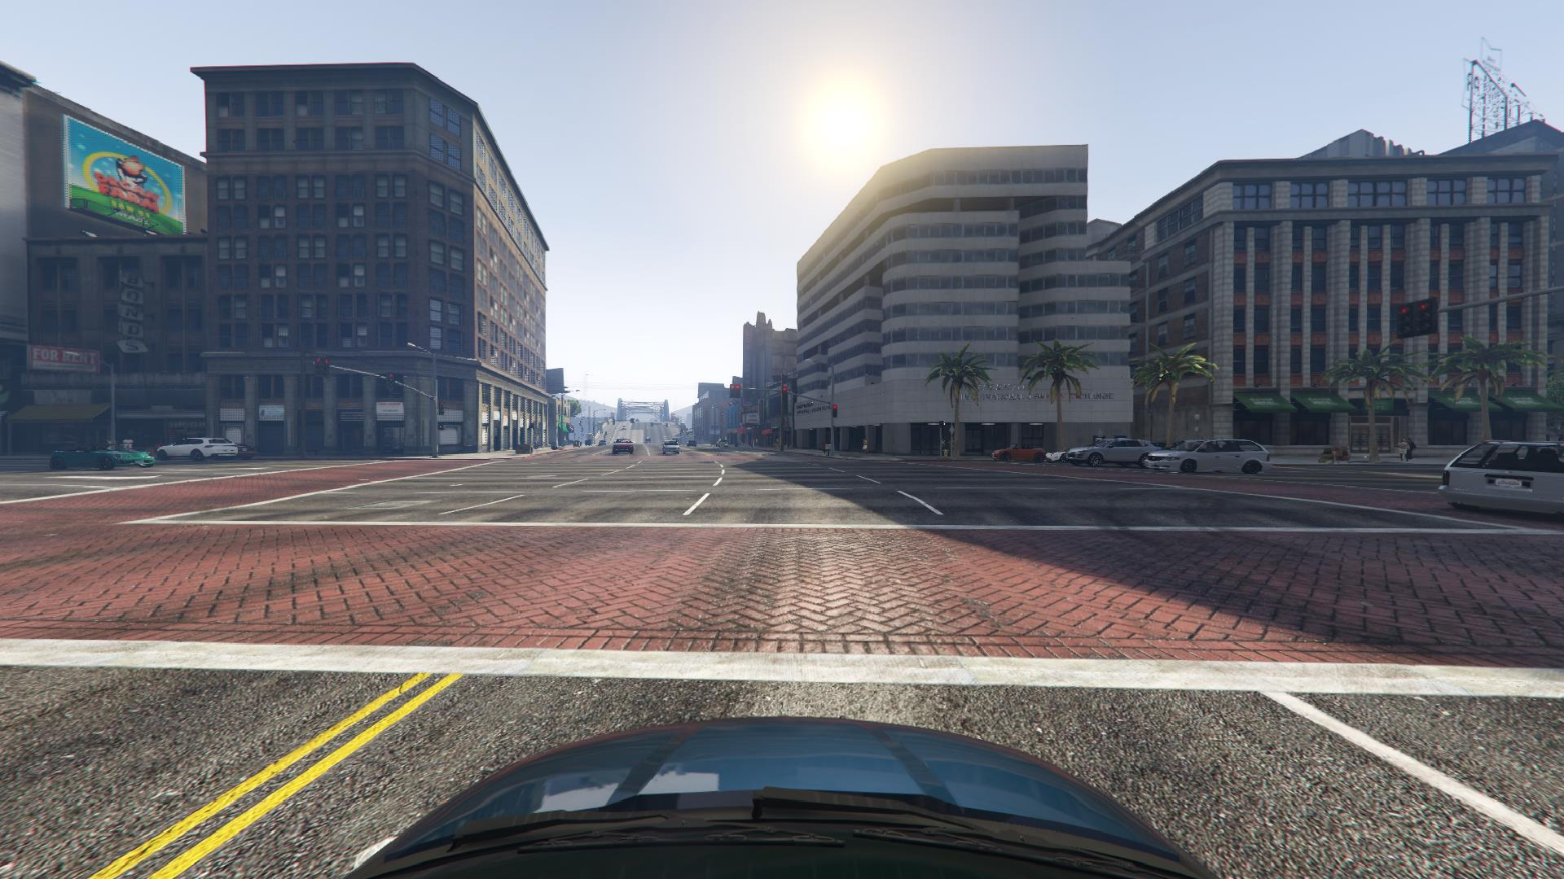
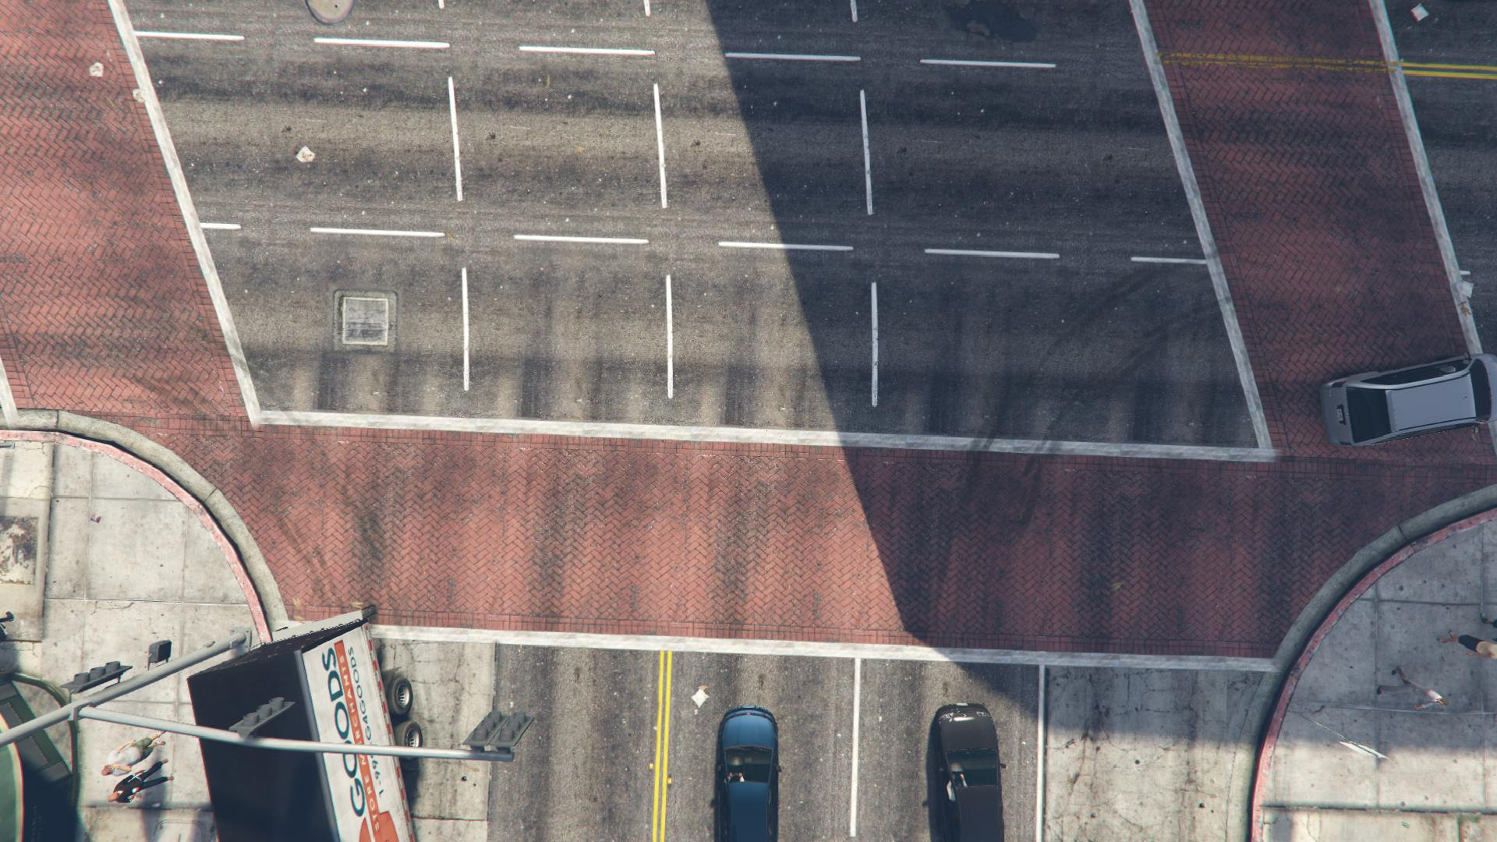
Background
Car View
Drone View
Viewing angle of Drone is larger than car and car provide precise observations on road
Line of Sight distance at daylight on average
Car driver 1000 ft
UAV upto 2000 ft
Human reaction time during events on road
0.7 seconds to 3 seconds based on age and situations
Which is prone to collision
UAV birds-eye view can aid with earlier event detection and buy more time to drivers for taking action
Notes:
Add graph for drone can see further than the car.
Put a statistics illustrating drone you can buy extra reaction time for the driver.

Slide 39
Problem Motivation
How to process videos with: 1) low latency, 2) high accuracy, 3) energy efficiency (the drone lasts longer).
Existing Approaches: | Limitations
Transmitting the raw video to the car | Requires high bandwidth usage High energy consumption at UAV Require processing the whole frame
Transmitting compressed video to the car | Will loose accuracy of event detection
Processing video on drones | Consumes high energy and reduces flight duration
Notes:
Add limitations of existing approaches

Slide 40
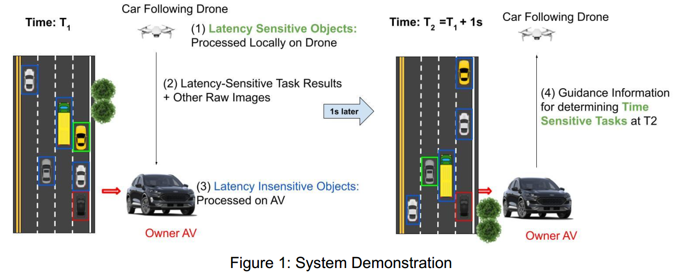
Our Solution
Key Novelty: only process latency-sensitive image regions on the drone

Slide 41
Project Selection and Grading
Feel free to propose your own project or join existing groups
Control your workload in reasonable range
For many of you this is your first time exposed to such topics, so we won’t grade harshly…. (last semester all students got A)
Your contribution determines whether you will be added as a co-author
Paper writing
Conduct experiments
Data analysis
Build system prototypes
…

Slide 42
Scalability and Elasticity with Cloud Computing
Elasticity = scalability + automation + optimization + resources
Equation for cloud computing

